Slide 1
Using R and Python for Scalable Data Science, Machine Learning, and AI
Debraj GuhaThakurta
Bob Horton
Ali Zaidi
John-Mark Agosta
Tomas Singliar
Mario Inchiosa

Slide 2
Using R and Python for Scalable Data Science, Machine Learning, and AI
Instructions at https://github.com/Azure/Strata2018
Open https://hostname:8000 (use https, not http; replace "hostname" with the hostname on the slip of paper you received when arriving). Disregard warnings about certificate errors.
Open a bash terminal window by clicking the New button and then clicking Terminal.
In the bash terminal, run these four commands:
cd ~/notebooks
git clone https://github.com/Azure/Strata2018
cd Strata2018
source startup.sh
You can now log in to RStudio Server at http://hostname:8787 (unlike JupyterHub, be sure to use http, not https).

Slide 3
Session Goals
Participants will learn how to
use pre-trained deep learning models and word embeddings to generate features that can be used in traditional machine learning approaches.
run these types of featurization at scale.
use an active learning process to take advantage of large sets of unlabeled data to build more accurate classifiers by selecting the most useful additional examples to label for training.

Slide 4
Use Cases
“Wiki detox”
Active learning from text data.
Binary classifier: is this comment a personal attack?
Featurization from pre-trained word embeddings.
Wood knot images
Active learning from image data.
Multi-class classifier: which type of knot is this
Featurization from pre-trained deep learning model (Resnet)

Slide 5
Technical Themes
Interoperability between Python and R
Scaling up on the cloud

Slide 6
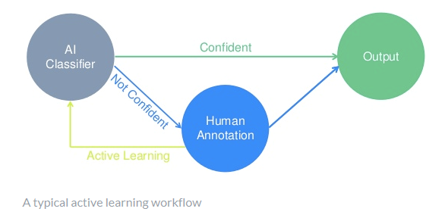
Active Learning
Active learning is a case of semi-supervised learning in which an algorithm interactively asks for additional labeled data that would result in most gain in model performance
Data (unlabeled) is often easier to come by than expert labelers
Active learning starts with a preliminary classifier and looks for the samples that it has the most to learn from
What is the model good at? What needs work (e.g., more training data)?
How much of the unlabeled data can we eliminate as already identifiable?
* Image taken from https://www.crowdflower.com
Notes:
Data is often easier to come by than expert labels
Use the preliminary model for triage of unlabeled data
What is the model good at? What needs work (e.g., more training data)?
How much of the unlabeled data can we eliminate as already identifiable?
Better model -> better triage -> better selection of cases to label -> better model -> ...
Companies like CrowdFlower and services like the Custom Vision Service use active learning.

Slide 7
Query strategies[edit]
Algorithms for determining which data points should be labeled can be organized into a number of different categories:^{[1]}
Uncertainty sampling: label those points for which the current model is least certain as to what the correct output should be
Query by committee: a variety of models are trained on the current labeled data, and vote on the output for unlabeled data; label those points for which the "committee" disagrees the most
Expected model change: label those points that would most change the current model
Expected error reduction: label those points that would most reduce the model's generalization error
Variance reduction: label those points that would minimize output variance, which is one of the components of error
Balance exploration and exploitation: the choice of examples to label is seen as a dilemma between the exploration and the exploitation over the data space representation. This strategy manages this compromise by modelling the active learning problem as a contextual bandit problem. For example, Bouneffouf et al.^{[7]} propose a sequential algorithm named Active Thompson Sampling (ATS), which, in each round, assigns a sampling distribution on the pool, samples one point from this distribution, and queries the oracle for this sample point label.
Exponentiated Gradient Exploration for Active Learning:^{[8]} In this paper, the author proposes a sequential algorithm named exponentiated gradient (EG)-active that can improve any active learning algorithm by an optimal random exploration.
Wikipedia: Active learning (machine learning)
https://en.wikipedia.org/w/index.php?title=Active_learning_(machine_learning)

Slide 8
Use Case 1: active learning for text classification data, data everywhere

Slide 9
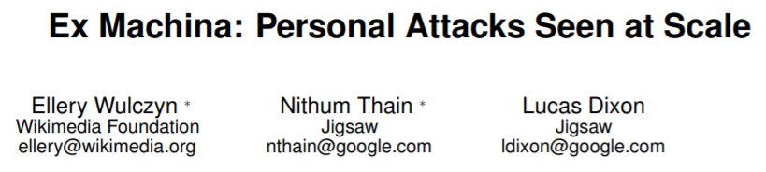
Wikipedia detox dataset
arXiv:1610.08914v2
Preliminary training set
(40 cases)
115k labeled cases
Pseudo-unlabeled cases
(105k)
Test set
(10k)
95M unlabeled cases

Slide 10
Word embeddings

Slide 11
Unreasonable Effectiveness of Data and Deep Architectures
performance
neural networks
traditional learners
training data
Revisiting Unreasonable Effectiveness of Data in Deep Learning Era, Google

Slide 12
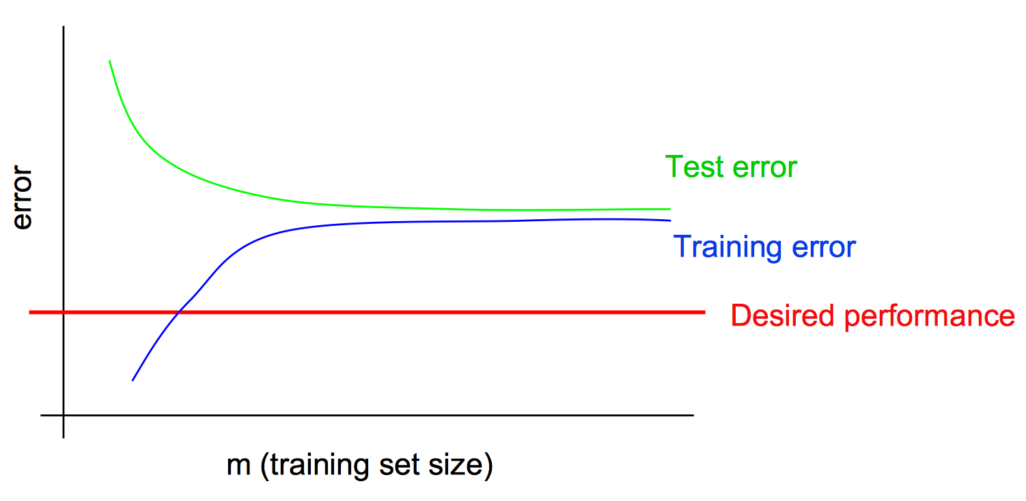
Model Complexity and Data Scarcity
In the low data regime, traditional (simple) bag-of-words models may outperform neural network models
Higher bias, lower variance
Andrew Ng, CS 229

Slide 13
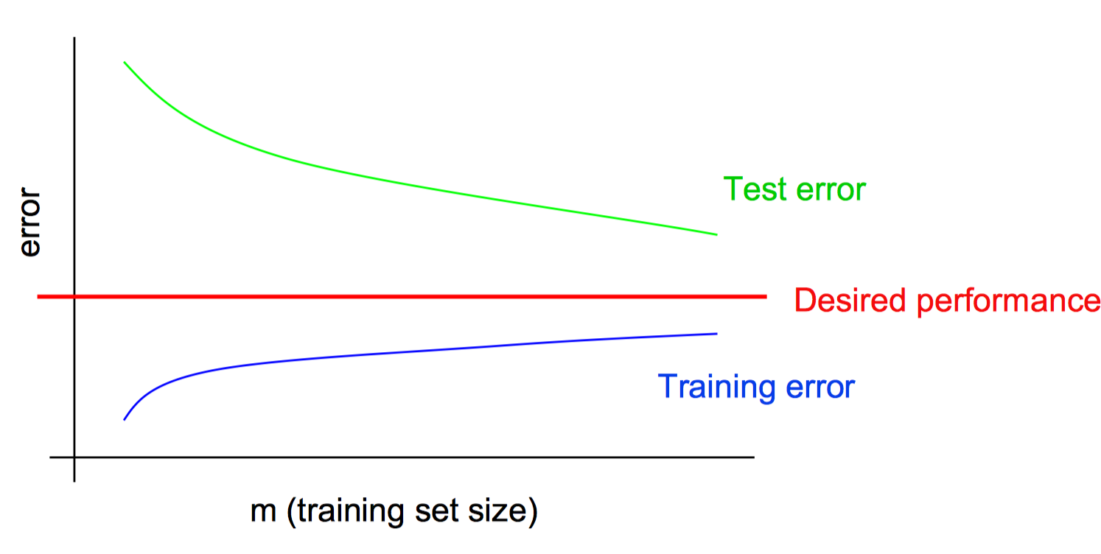
Model Complexity and Data Scarcity
With high capacity models, you need more data to tune the model appropriately
Higher variance, lower bias
Andrew Ng, CS 229

Slide 14
Bias-Variance Tradeoff and Performance Diagnostics
We have an intrinsic need to balance the capacity of our models with the amount of data we have
What turns out to be especially important, is the amount of labeled data that we can turn into features
Use better features (differentiable programming to automatically learn good features)
Use a higher capacity model
Label more data
Apply regularization / shrinkage

Slide 15
Featurizing Text data, data everywhere

Slide 16
One-hot representation (local)
Dim = |V| sim(banana, mango) = 0
banana
0
0
0
0
0
1
0
0
0
0
0
0
mango
0
0
0
0
0
0
0
0
0
1
0
0
Notes: 1) Popular sim() is cosine, 2) Words/tokens come from some tokenization and transformation

Slide 17
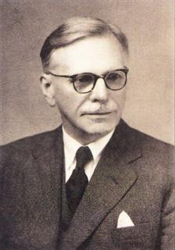
Context-based distributed representation
Non-zero
Zero
banana
mango
sim(banana, mango) > 0
Appear in same documents
Appear near same words
“
You shall know a word by the company it keeps
”
Firth, J. R. (1957). A synopsis of linguistic theory 1930–1955. In Studies in Linguistic Analysis, p. 11. Blackwell, Oxford.
Turney and Pantel. From frequency to meaning: Vector space models of semantics. Journal of artificial intelligence research 2010

Slide 18
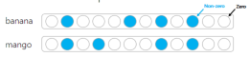
Distributed and distributional
Distributed representation: Vector represents a concept as a pattern, rather than 1-hot
Distributional semantics: Linguistic items with similar distributions (e.g. context words) have similar meanings
Distributional methods use distributed representations
“
You shall know a word by the company it keeps
”
http://www.marekrei.com/blog/26-things-i-learned-in-the-deep-learning-summer-school/

Slide 19
Embeddings (distributed)
Dense. Dim = 200 (for example)
banana
mango
dog

Slide 20
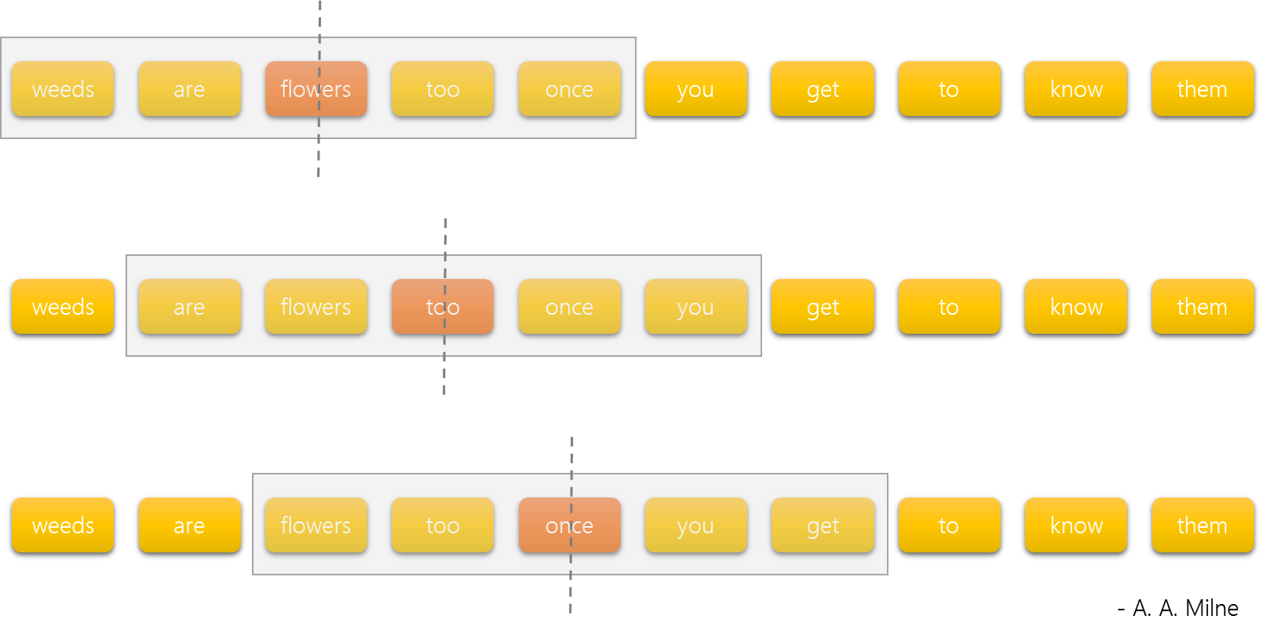
Word2vec
Goal: simple (shallow) neural model learning from billion words scale corpus
Predict middle word from neighbors within a fixed size context window
Two different architectures:
Skip-gram
CBOW
(Mikolov et al., 2013)

Slide 21
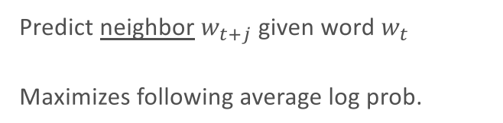
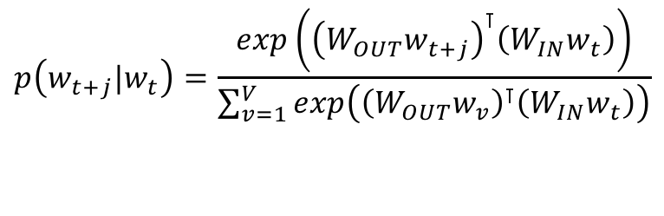
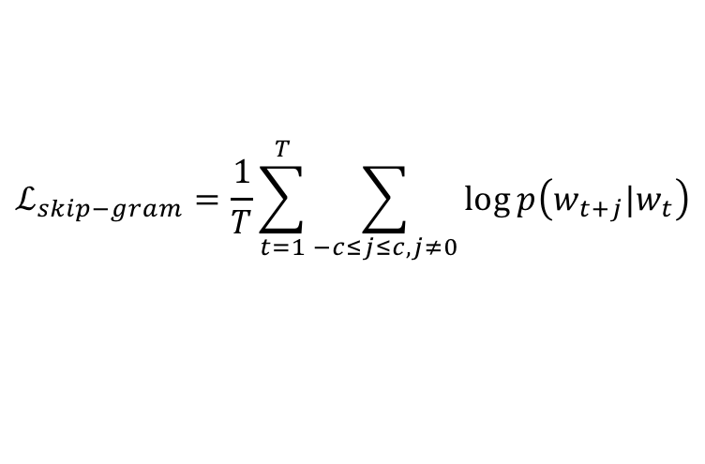
Skip-gram
Predict neighbor $w_{t+j}$ given word $w_{t}$
Maximizes following average log prob.
w_{t}
W_{IN}
W_{OUT}
w_{t+j}
$$ℒ_{skip−gram}=\frac{1}{T}\sum_{t=1}^{T}{\sum_{−c≤j≤c, j≠0}{\log{p\left(w_{t+j}|w_{t}\right)}}}$$
$$p\left(w_{t+j}|w_{t}\right)=\frac{exp\left({\left(W_{OUT}w_{t+j}\right)}^{⊺}\left(W_{IN}w_{t}\right)\right)}{\sum_{v=1}^{V}{exp\left({\left(W_{OUT}w_{v}\right)}^{⊺}\left(W_{IN}w_{t}\right)\right)}}$$
Full softmax is computationally impractical. Word2vec uses hierarchical softmax or negative sampling instead.
(Mikolov et al., 2013)

Slide 22
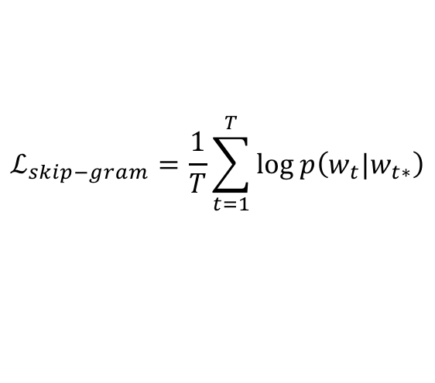
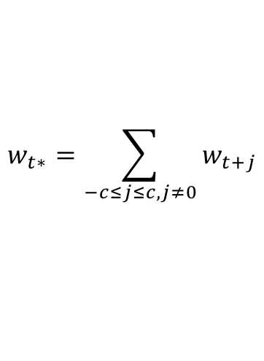
Continuous Bag-of-Words
w_{t+2}
Predict word given bag-of-neighbors
Modify the skip-gram loss function.
w_{t+1}
W_{IN}
W_{OUT}
w_{t}
$$ℒ_{skip−gram}=\frac{1}{T}\sum_{t=1}^{T}{\log{p\left(w_{t}|w_{t∗}\right)}}$$
w_{t-1}
w_{t*}
$$w_{t∗}=\sum_{−c≤j≤c, j≠0}{w_{t+j}}$$
w_{t-2}
(Mikolov et al., 2013)

Slide 23
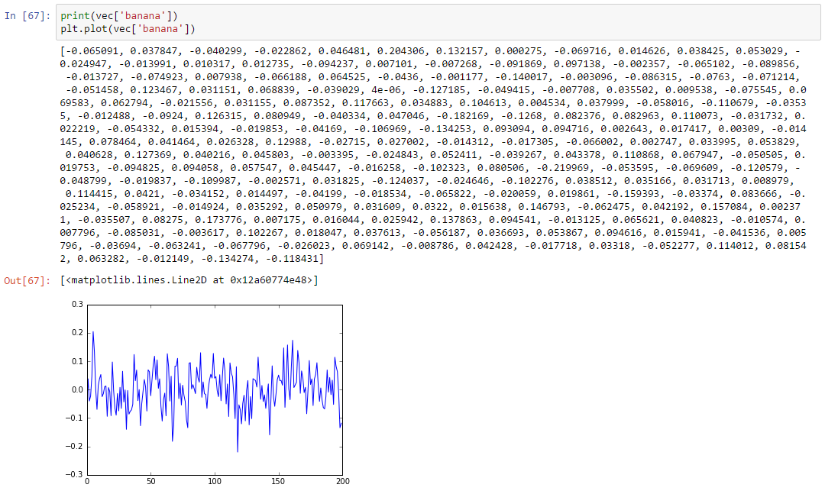

Slide 24
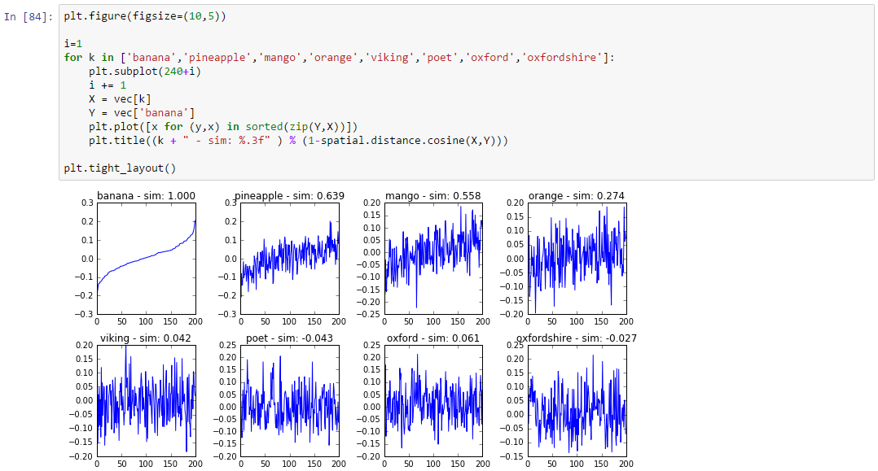

Slide 25
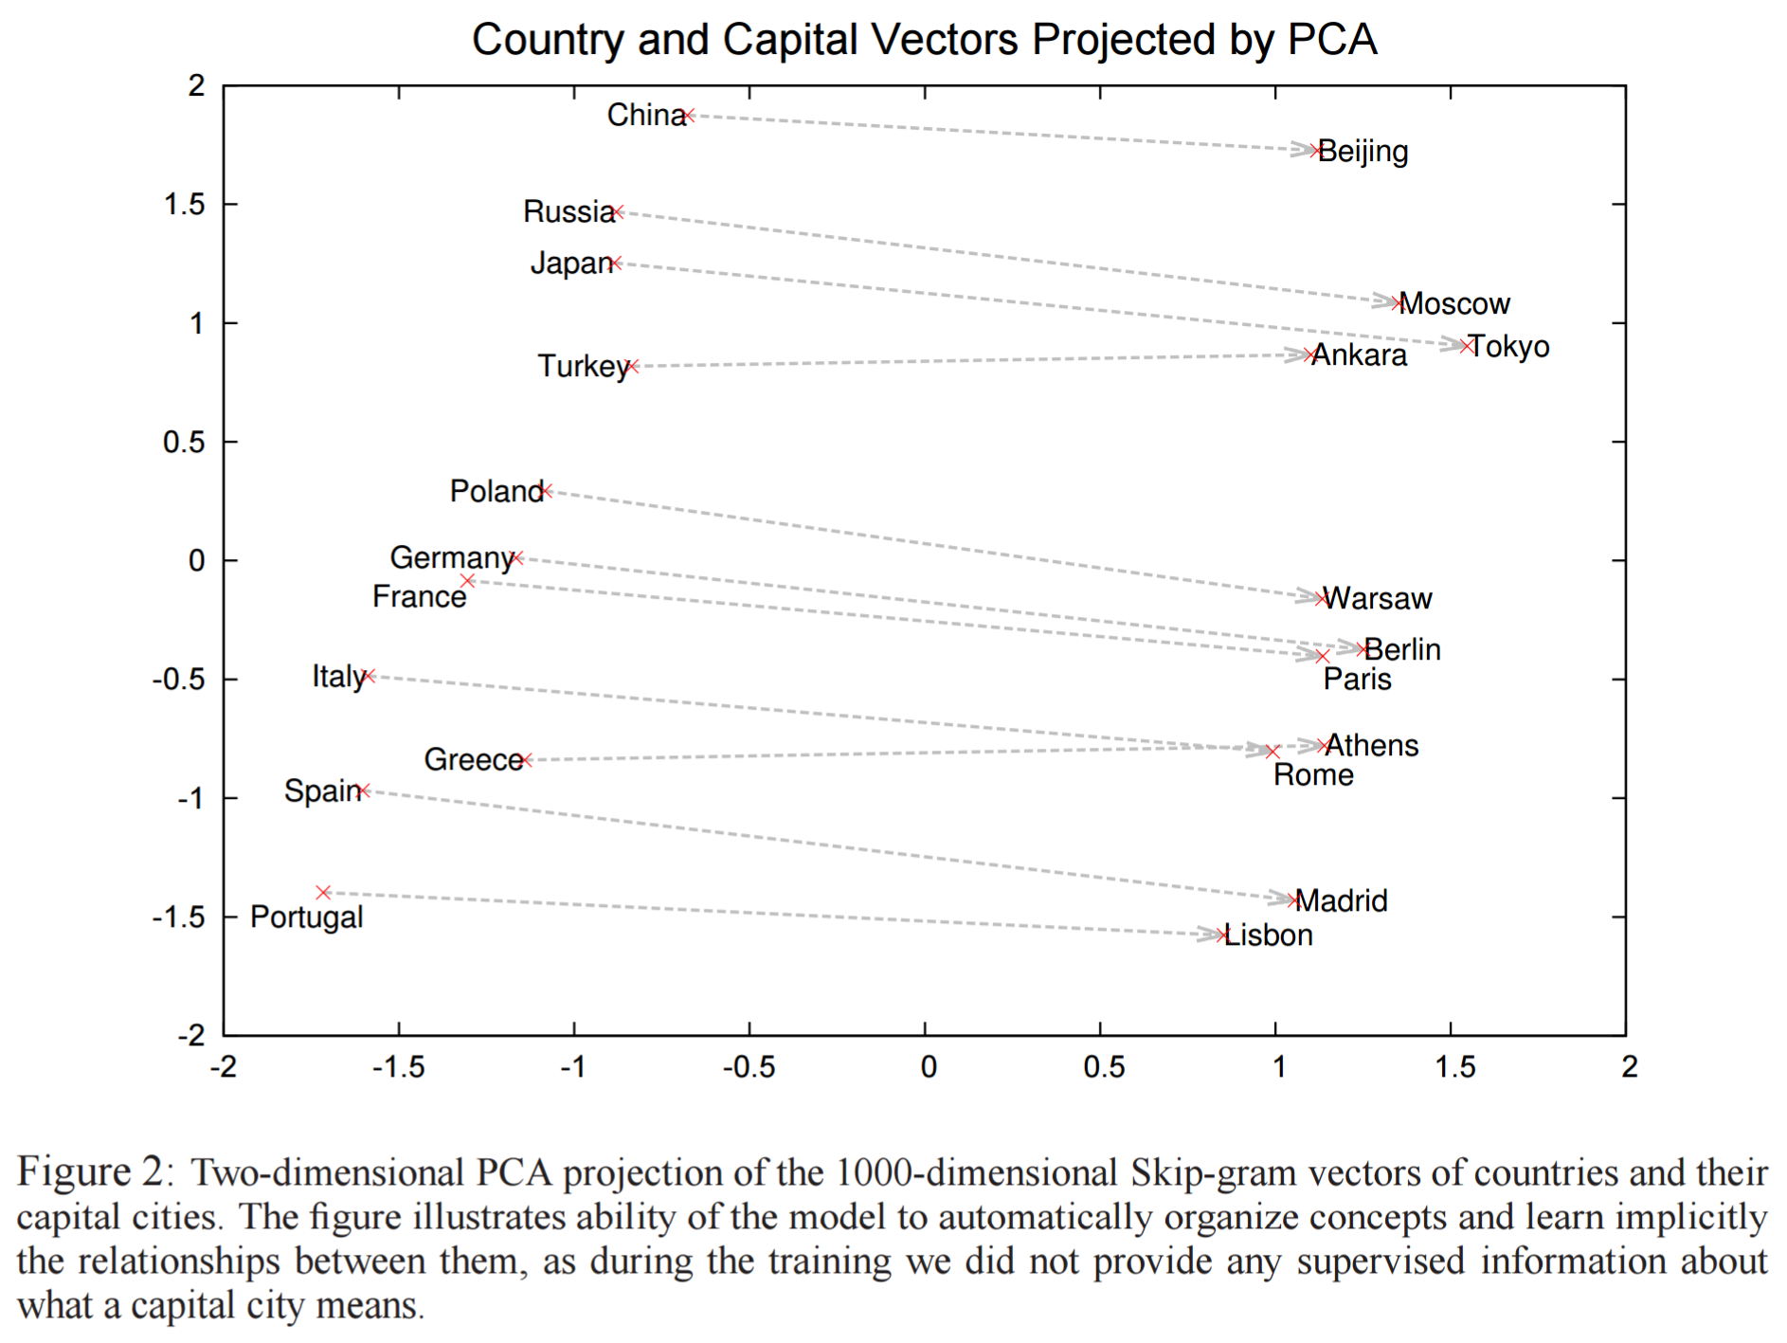
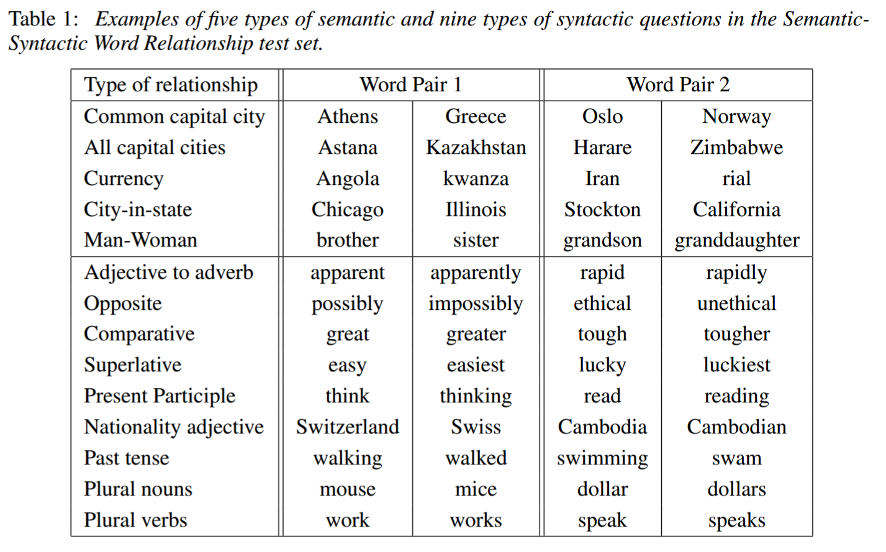
Word analogies with word2vec
[king] – [man] + [woman] ≈ [queen]
(Mikolov et al., 2013)

Slide 26
Word analogies can work in underlying data too
seattle
denver
jerseys
wilson
browner
lynch
miller
map
seahawks
broncos
highlights
sherman
lfedi
sanchez
marshall
weather
seattle
seahawks
denver
broncos
similar
[seahawks] – [seattle] + [Denver]
Sparse vectors can work well for an analogy task:
Levy, Goldberg and Ramat-Gan. Linguistic Regularities in Sparse and Explicit Word Representations. CoNLL 2014

Slide 27
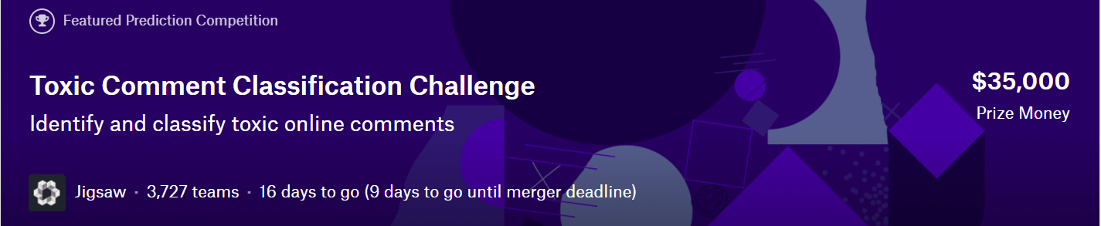
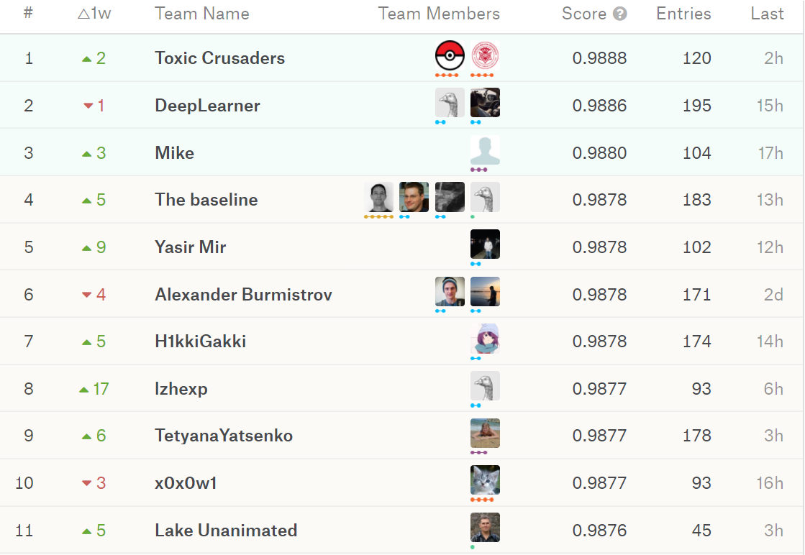

Slide 28
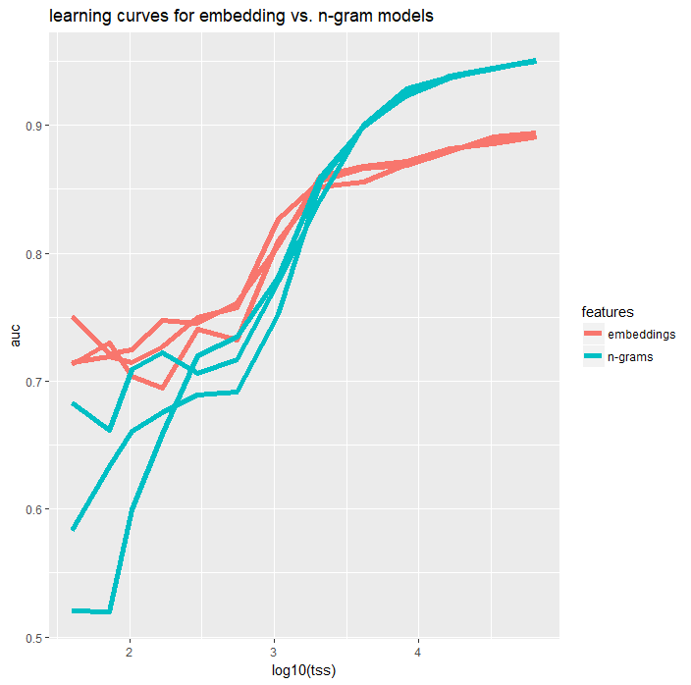

Slide 29
Visualizing word and document embeddings
Activity 1A

Slide 30
Training a word embedding
Activity 1B

Slide 31
Active learning on text
Activity 1C

Slide 32
Intermission

Slide 33
Use Case 2: Building a custom image classifier for wood knots

Slide 34
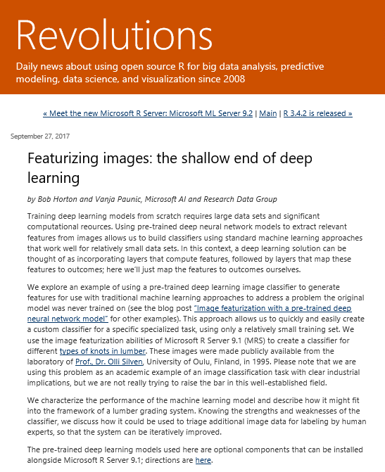
Featurizing images: the shallow end of deep learning
http://blog.revolutionanalytics.com/2017/09/wood-knots.html

Slide 35
Domain: Wood Knots and Lumber Grading
In the sawmill industry lumber grading is an important step of the manufacturing process.
Improved grading accuracy and better control of quality variation in production leads directly to improved profits.
Grading has traditionally been done by visual inspection, in which a (human) grader marks each piece of lumber as it leaves the mill, according to a factors like size, category, and position of knots, cracks, species of tree, etc.
A number of automated lumber grading systems have been developed which aim to improve the accuracy and the efficiency of lumber grading.
Notes:
In the sawmill industry lumber grading is an important step of the manufacturing process. Improved grading accuracy and better control of quality variation in production leads directly to improved profits. Grading has traditionally been done by visual inspection, in which a (human) grader marks each piece of lumber as it leaves the mill, according to a factors like size, category, and position of knots, cracks, species of tree, etc. Visual inspection is often an error prone and laborious task. Certain defect classes may be difficult to distinguish, even for a human expert. To that end, a number of automated lumber grading systems have been developed which aim to improve the accuracy and the efficiency of lumber grading.

Slide 36
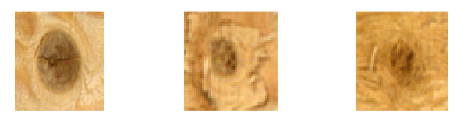
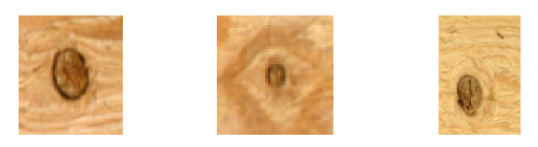
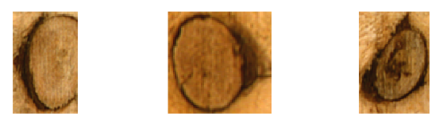
Types of wood knots
Sound knot: A knot grown firmly into the surrounding wood material and does not contain any bark or signs of decay. The color may be very close to the color of sound wood.
Dry knot: A firm or partially firm knot, and has not taken part to the vital processes of growing wood, and does not contain any bark or signs of decay. The color is usually darker than the color of sound wood, and a thin dark ring or a partial ring surrounds the knot.
Encased knot: A knot surrounded totally or partially by a bark ring. Compared to dry knot, the ring around the knot is thicker.

Slide 37
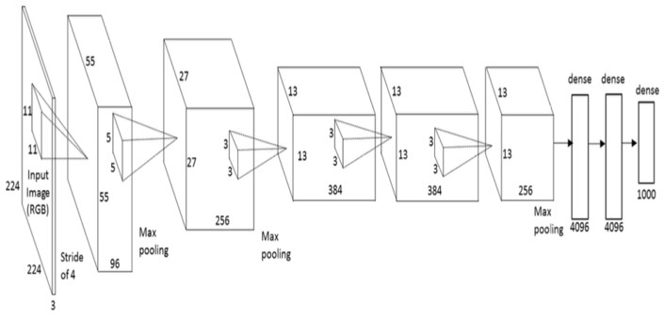
Image Featurization in Microsoft ML Server
Starting with Microsoft R Server 9.1, the MicrosoftML package has added support for pre-trained deep neural network models for image featurization.
We can now use the following four deep neural network models trained on ImageNet data set to extract features from images.
ResNet-18
ResNet-50
ResNet-101
AlexNet
Output features
Input image

Slide 38
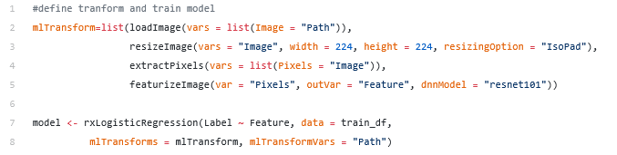
Image Featurization in Microsoft ML Server
Usage of these pre-trained models allows us to take advantage of their features hard learned from previous data sets which would be otherwise impossible or very inefficient to feature engineer.
Heuristically, the larger the model, the better the performance but the longer it takes to run.
* Code snapshot taken from https://blogs.msdn.microsoft.com/mlserver/2017/04/12/image-featurization-with-a-pre-trained-deep-neural-network-model/

Slide 39
Featurizing Images at Scale
Activity 2A

Slide 40
Visualizing image feature vectors as embeddings
Activity 2B

Slide 41
Active learning on images
Activity 2C

Slide 42
Image Labeling Exercise
Activity 2D

Slide 43
Label Quality

Slide 44
Careful with the data
In the era of big data and machine learning
labels -> features -> predictive model -> optimization
Labeling/experimentation perceived as boring
Tendency to rush labeling
Label quality is very important
Garbage in, garbage out

Slide 45
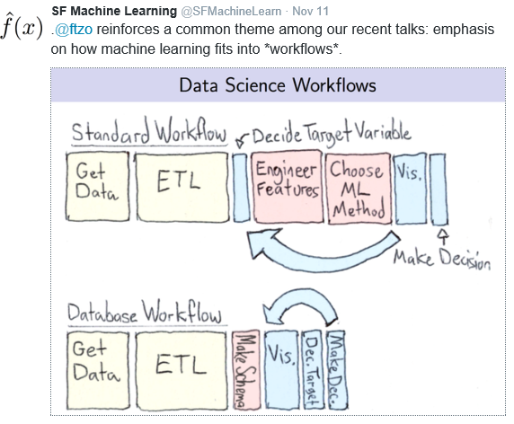
Big data, ML, and data science
Labels -> features -> predictive model -> optimization

Slide 46
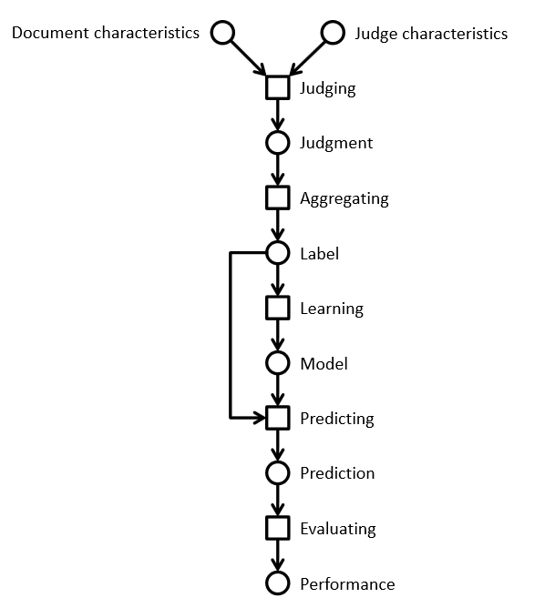
Lifecycle of a label
Information retrieval example
Using a crowd to label a data set
Using ML to process the complete data set

Slide 47
Label quality
Quality
Meets internal customer needs
Free from deficiencies
Process
Don’t rush labeling
Don’t outsource
Own it end to end
Large scale
Continuity

Slide 48
Development process
Small data set
Crowd-based
Payment structure
Flexible quality
Data set partitioned
Crowd-based
Quality control enforced
Expertise, retention, recruiting
Small data set
Internal team
Mostly for testing
HIT Prototype
Laboratory Release
Pilot
Test
Production
System
Coding
Quality control
Quality improvements
Time

